Slide 1
CUHKSZ Food Rating and Recommendation System
Group members:
Xu Kai 121090650
Zhang Zirui 122090784
Chen Fanxinyu 121090028
Cai Liuyu 121040046
Lin Yuzhou 122090324
Li Tao 121090279
Yu Jinlin 121090729
Zhou Can 120090397

Slide 2
1、Introduction
2、Database Design
CONTENTS
3、Implementation and Simple Queries
4、Data Mining
5、Interaction with LLM

Slide 3
01
Introduction

Slide 4



Motivation
Exsisting successful cases:

Slide 5
Motivation
Exsisting successful cases:
Provide reliable reference when choosing restaurant
Urge restaurants to provide better dishes and service to attract customers

Slide 6
02
Database Design

Slide 7
Database Design
be capable to shows the popularity of a dish
Basic Functions
be capable to display the detail information of dish and its location

Slide 8
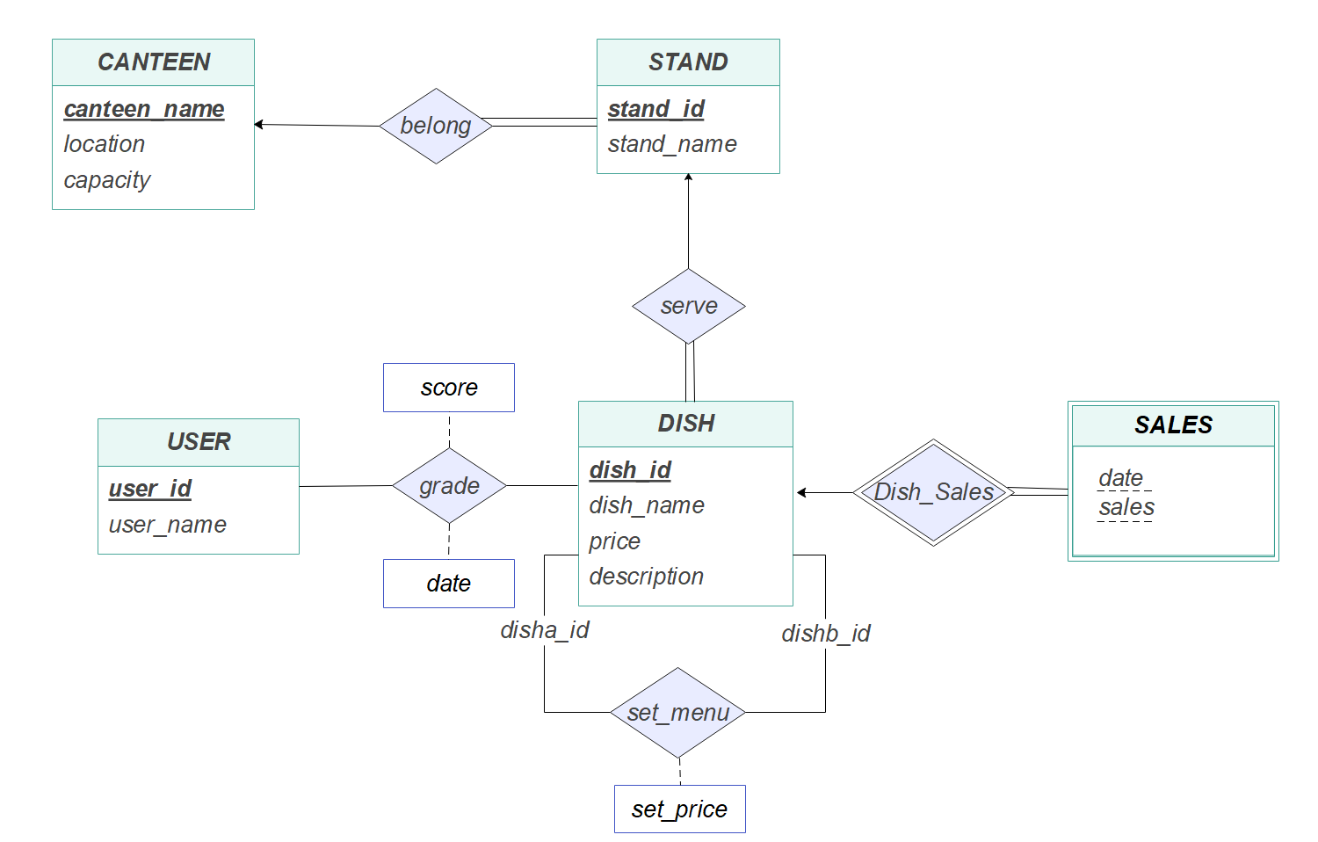
Database Design
Premise:
1. No canteen shares same name in CUHKSZ
2. A dish must serve by a stand, a stand must belongs to a canteen
ER Diagram

Slide 9
Database Design
Premise:
1. No canteen shares same name in CUHKSZ
2. A dish must serve by a stand, a stand must belongs to a canteen
ER Diagram

Slide 10
Database Design
Premise:
1. No canteen shares same name in CUHKSZ
2. A dish must serve by a stand, a stand must belongs to a canteen
ER Diagram

Slide 11
Database Design
Premise:
1. No canteen shares same name in CUHKSZ
2. A dish must serve by a stand, a stand must belongs to a canteen
evaluate the popularity of a dish
ER Diagram

Slide 12
Database Design
Premise:
1. No canteen shares same name in CUHKSZ
2. A dish must serve by a stand, a stand must belongs to a canteen
ER Diagram

Slide 13
Database Design
Premise:
1. No canteen shares same name in CUHKSZ
2. A dish must serve by a stand, a stand must belongs to a canteen
ER Diagram

Slide 14
Database Design
Premise:
1. No canteen shares same name in CUHKSZ
2. A dish must serve by a stand, a stand must belongs to a canteen
ER Diagram

Slide 15
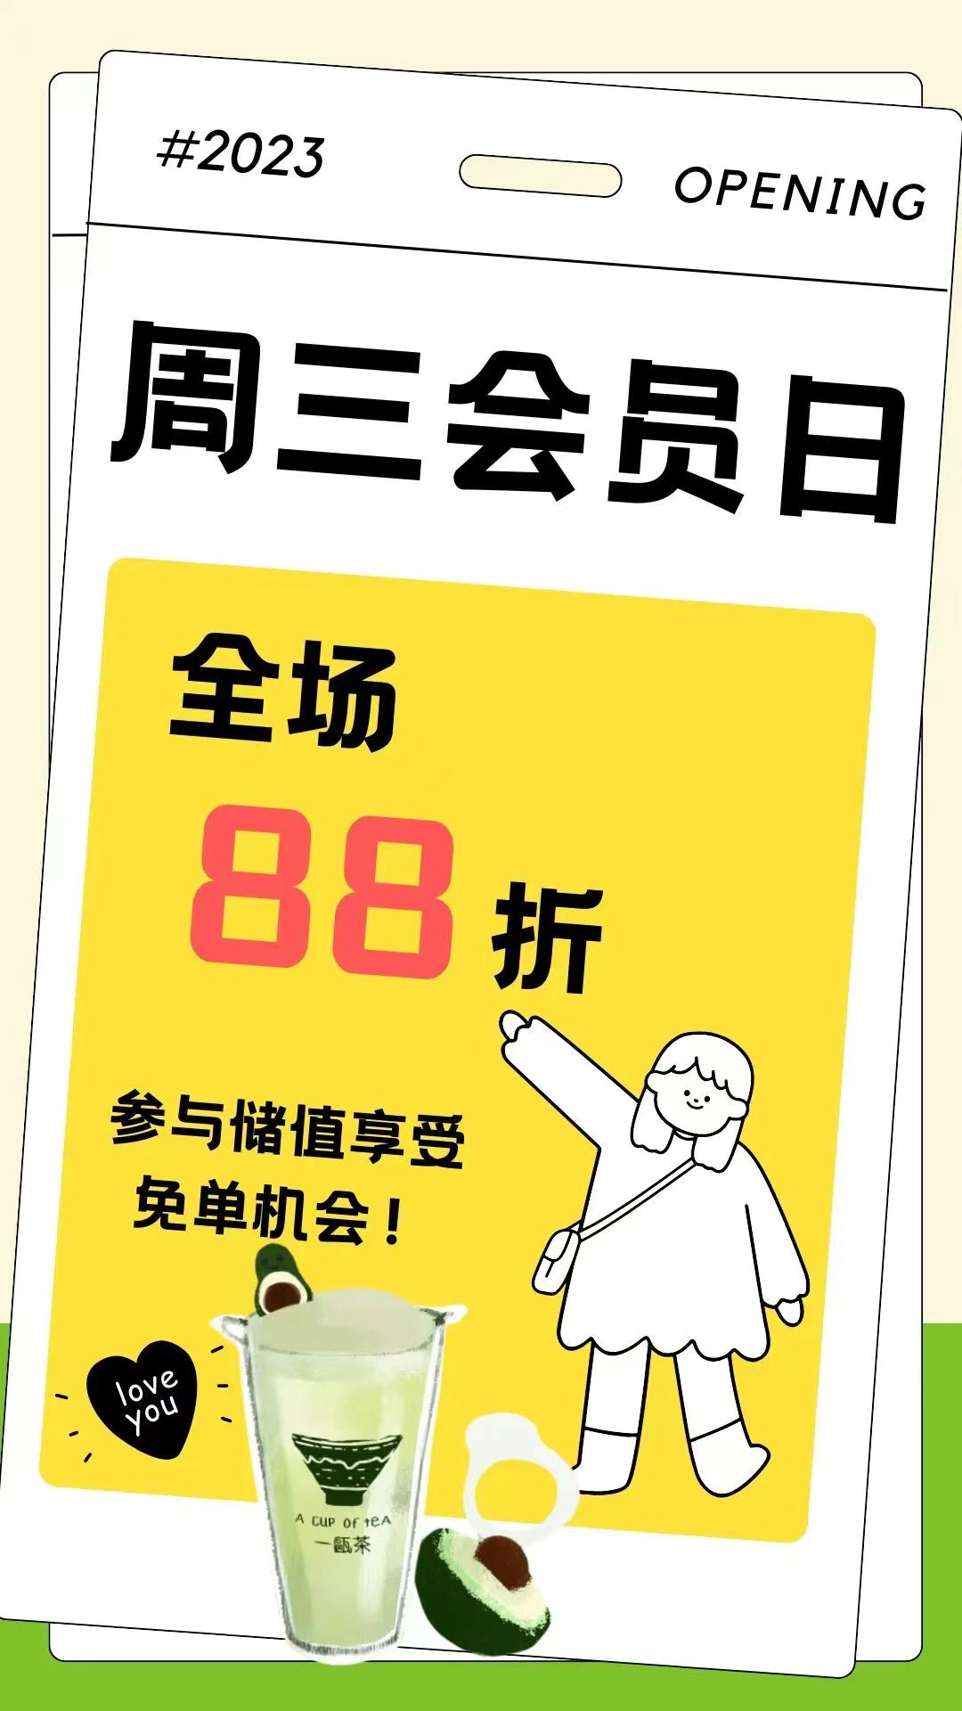
Database Design
Premise:
1. No canteen shares same name in CUHKSZ
2. A dish must serve by a stand, a stand must belongs to a canteen
ER Diagram

Slide 16
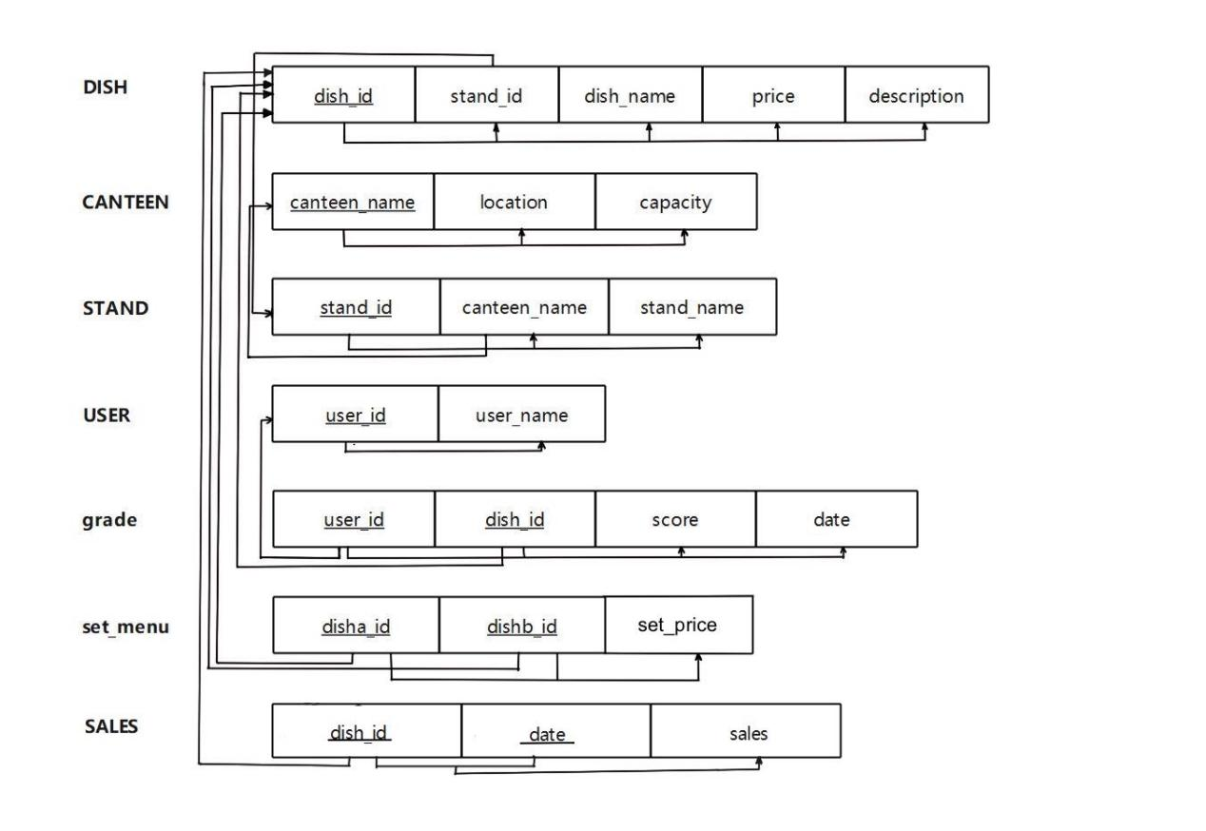
Database Design
Functional dependencies:
BCNF!

Slide 17



Data Collecting
Quenstionnaire
Data
Random generation

Slide 18
03
Implementation and Simple Queries

Slide 19
Three Features of Our Implementation
Flexibility
Transaction Support
Interactivity

Slide 20





Flexibility
All implemented in Python:
Has flexible structure, easy to modify and expand
PyMySQL: MySQL operations
Streamlit: Web construction
PyTorch: Data mining
ChatGPT API: Interaction with LLM

Slide 21
Transaction Support
Structure:
try:
cursor = db.cursor()
cursor.execute(sql)
db.commit()
print(‘succeed’)
except:
db.rollback()
finally:
cursor.close()
db.close()

Slide 22
Interactivity
Core Idea:
Package SQL queries as functions
Integrate functions on our web
Transform functions into user-friendly operations
Easy interaction with database via web

Slide 23
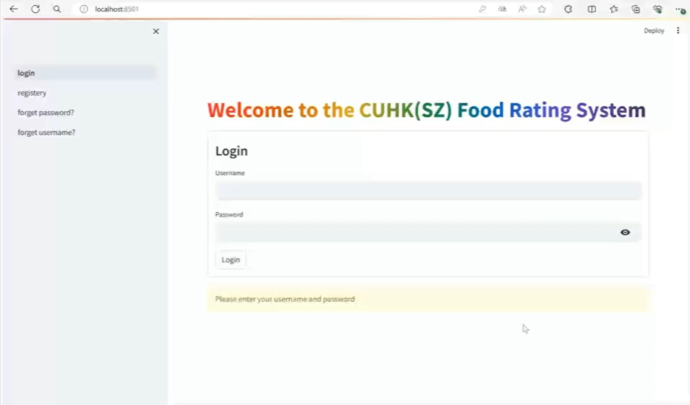
SQL+Web: Authentication
Passwords are encrypted using a hash function and stored in a config file to enhance security.
with open(‘filename’) as file:
config = yaml.load(file, Loader=SaferLoader)
Authenticator = stauth.Authenticate()

Slide 24
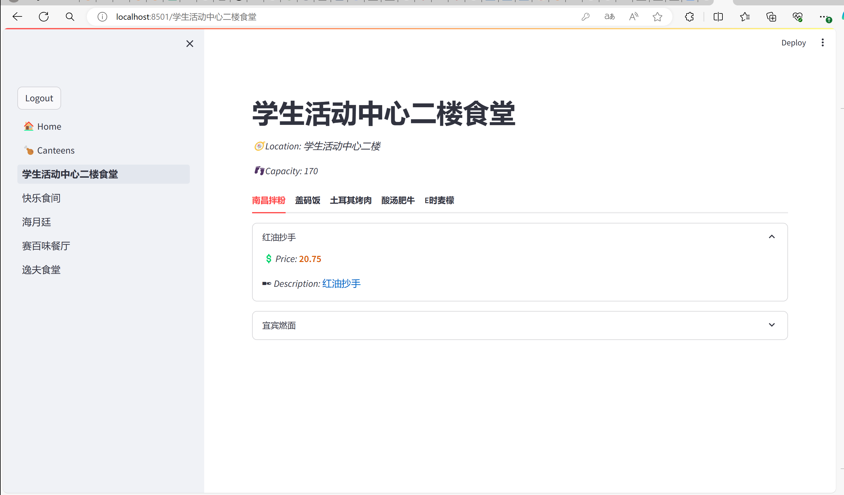
SQL+Web : Canteen information
SQL searches among relations to extract detail information for item
tabs = st.tabs(standName)
for i, tab in enumerate(tabs):
with tab:
for j, dish in enumerate(dishName):
show dish infomation

Slide 25
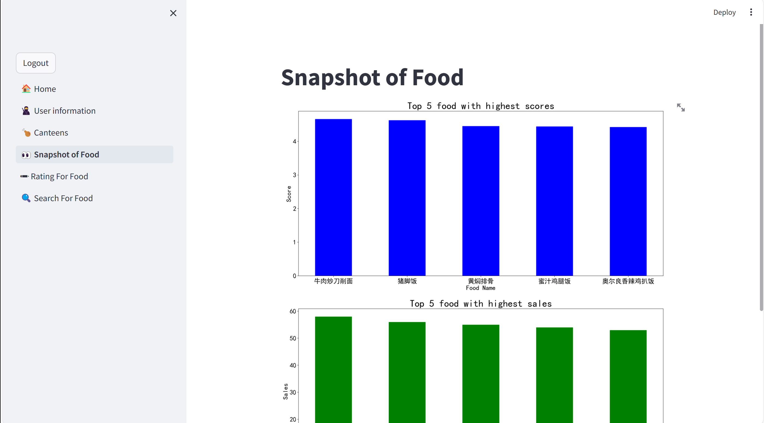
SQL+Web ：Snapshot
SQL selects top 5 dishes with highest rating or sales
topScores, topScoreNames = find_5_top_scores()
topSales, topSalesNames = find_5_top_sales()
fig = plt.figure()
ax1 = fig.add_subplot(gs[0])
ax2 = fig.add_subplot(gs[1])
ax1.bar(topScoreNames, topScores)
ax2.bar(topSalesNames, topSales)
st.pyplot(fig)

Slide 26
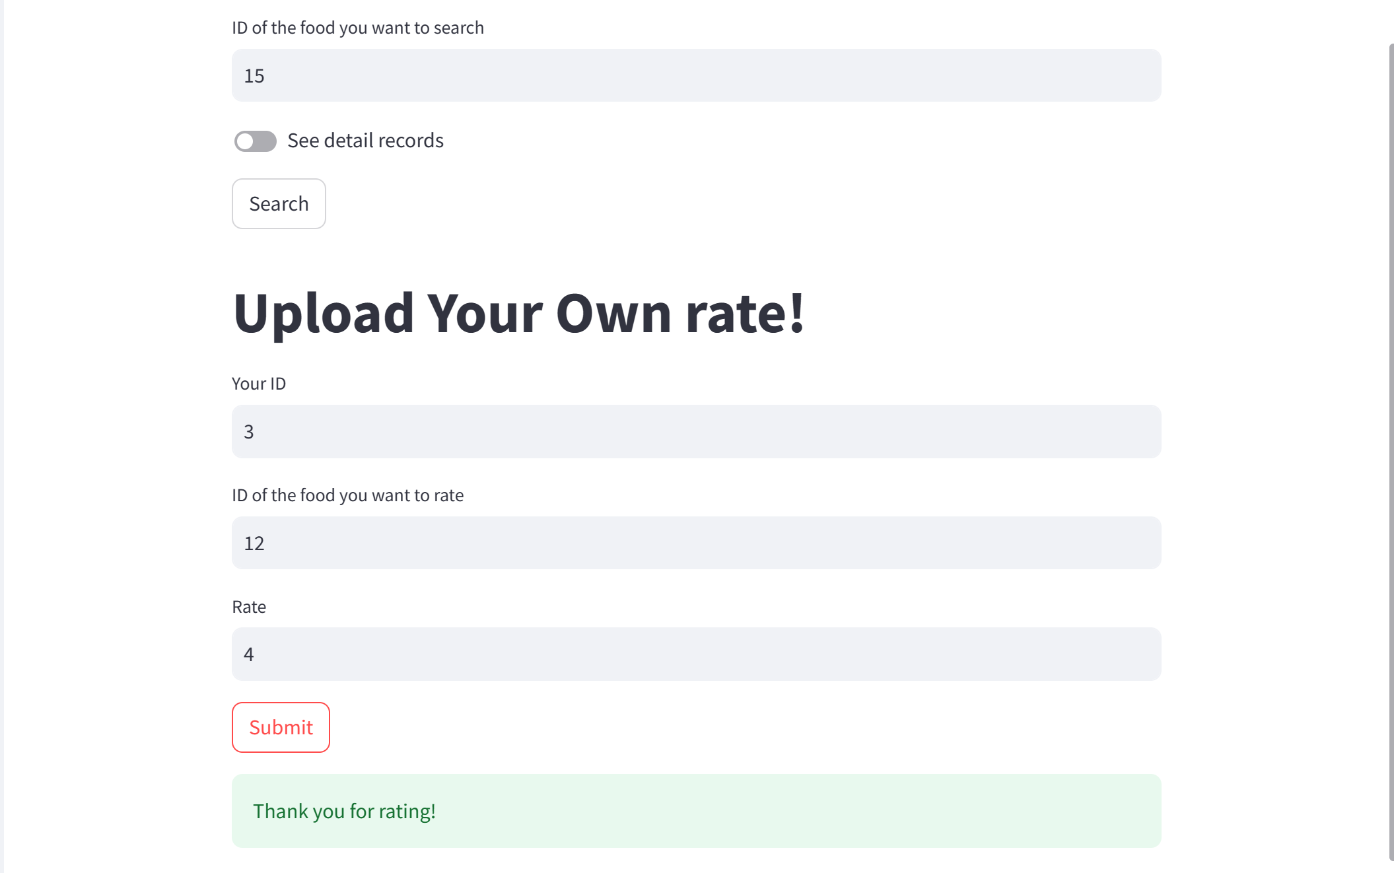
SQL+Web: Rating
SQL searches the detail rating records of certain dish and writes new rating records into database
with db_config.cursor() as cursor:
cursor.execute(grade_sql)
avg_score, record_count = cursor.fetchone()
…
date=data.today().strftime(‘%Y-%m-%d’)
with db_config.cursor() as cursor:
cursor.execute(insert_grade_sql)
db_config.commt()

Slide 27
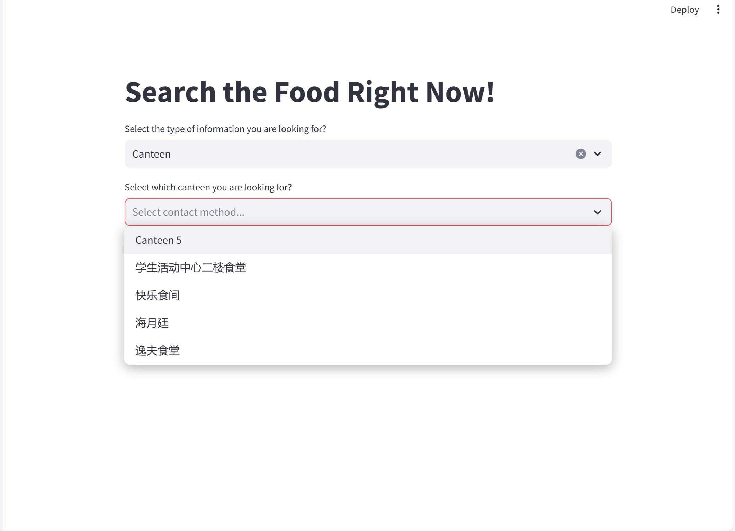
SQL+Web: Dish Rating Search
SQL searches information of Food or Stand by ID, Canteen by selections.
if option==‘Food’ or option==‘Stand’:
id=place.text_input(‘enter the ID’)
if option==‘Canteen’:
id=place.selectbox(‘select canteen’, (‘c1’, ‘c2’…))
submitted = st.form_submit_button(‘Search’)

Slide 28
04
Data Mining

Slide 29
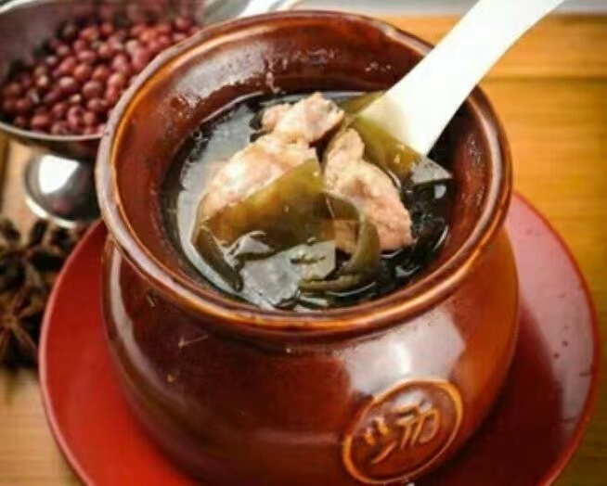

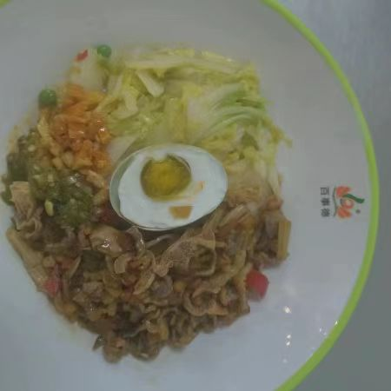
Overview of Our Recommendation System
Goal: Make personalized recommendation of dishes for each user .
like or not ?
like or not ?
Method: Learn feature vector for each user and dish by machine learning.

Slide 30
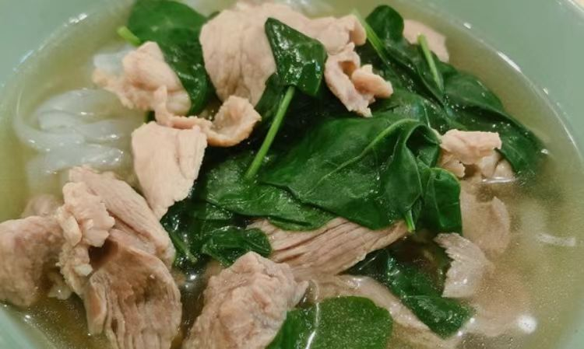
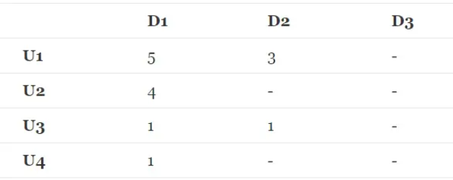
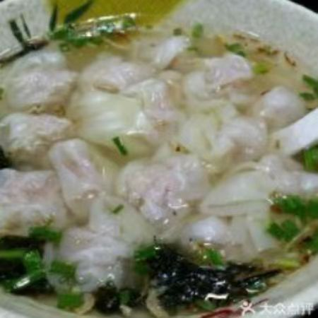
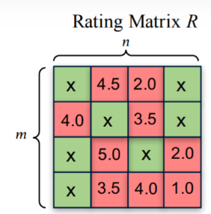
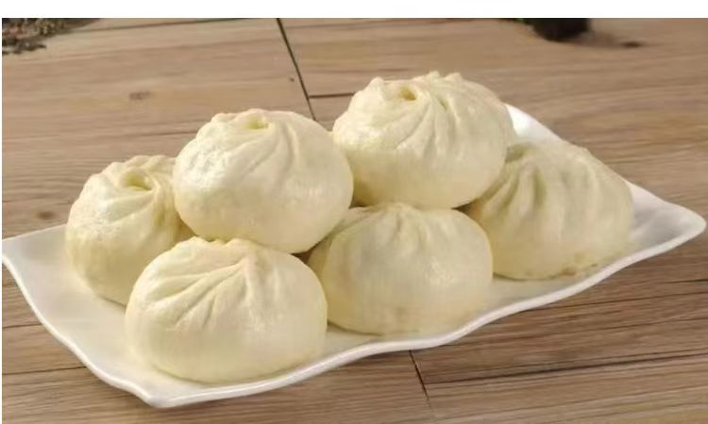
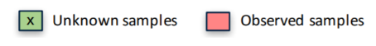
Extract User-Dish Rating Matrix from DB for Recommendation
User-Dish Rating Matrix R
Rating: 3
Rating: 5
Data Base
SQL
Rating: 1

Slide 31
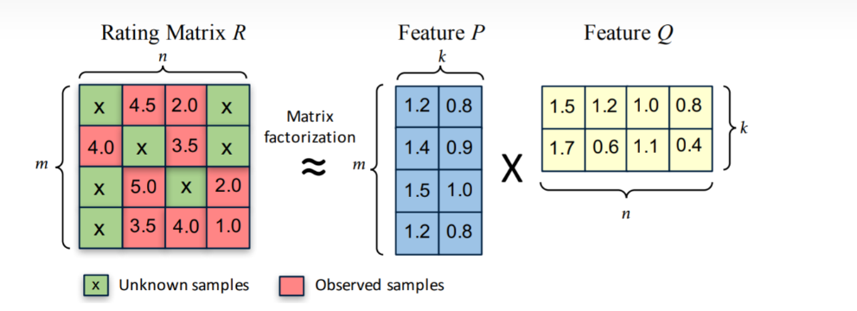
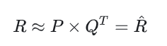
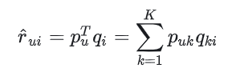
Learn Feature Vectors by Decomposing R
Prediction
（1）

Slide 32
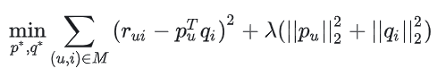
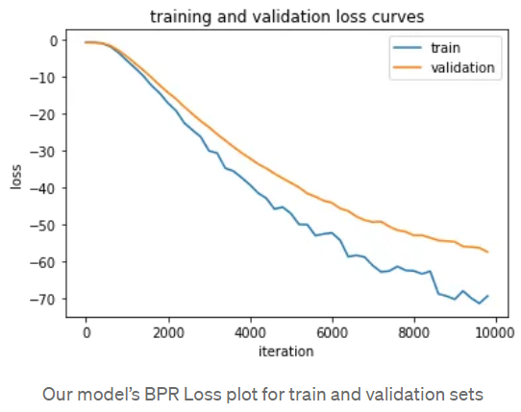
Model Training
Objective :
（2）
M: set of existing rating pairs

Slide 33
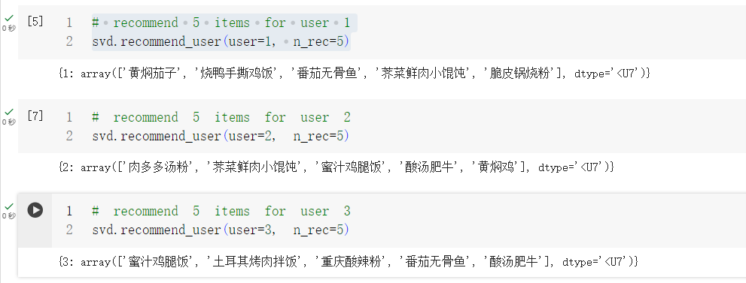
Examples

Slide 34
05
Interaction with LLM

Slide 35
ChatGPT-3.5
Improve data access efficiency
Generate accurate queries

Slide 36
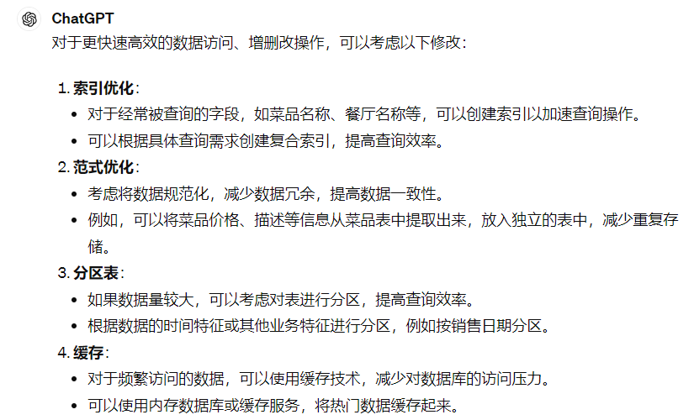
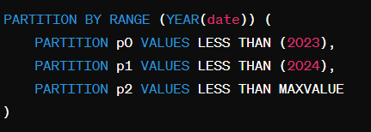
Improve Data Access Efficiency
Prompt:
ChatGPT answers
1. Create index on ‘DISH_ID’ of relation ‘Grade’
Changes in our DB
2. Partition relation ‘SALES’ by attribute ‘date’.

Slide 37
Self-Correction Model
self correct
local API
input comment
error
SQL Generator
generate and execute SQL query
re_generate
not satisfied
input
success
Check result
data base schames
query demand
satisfied
output result

Slide 38
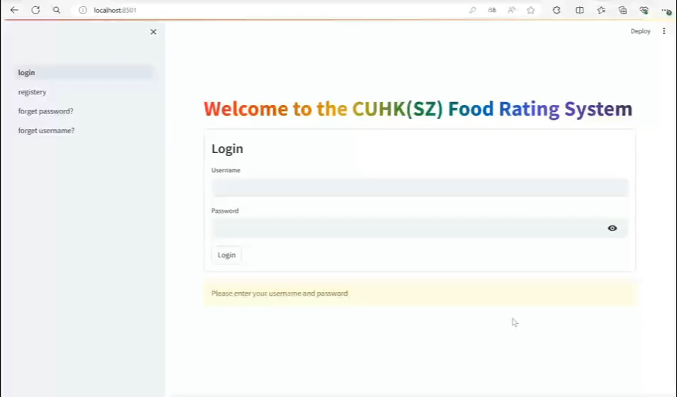

Slide 39
THANK YOU

